Slide 1
Bloomfield ZBA Meeting
69 Brown Street
Appeal Application
April 7, 2025

Slide 2

Maulucci Companies Listed From FAHA Records And Other Online Sources With An Address Listed As 69 Brown Street, Bloomfield:
Maulucci Construction
M&M Construction
Maulucci Home Builders
CT Drainage Pros
Maulucci Properties, LLC
Sweat Equity, LLC
Coastal Assets, LLC

Slide 3
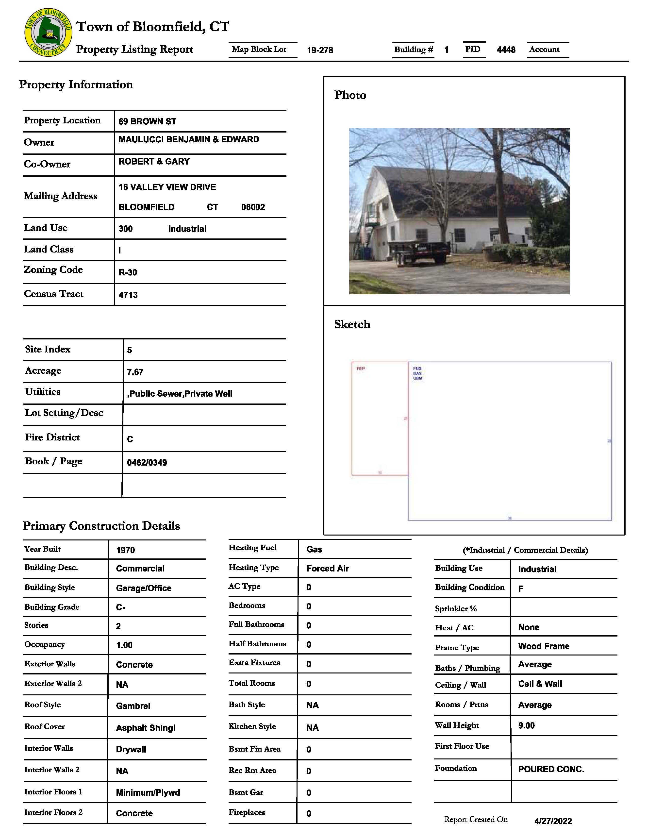
Town Assessor Card
April 2022

Slide 4
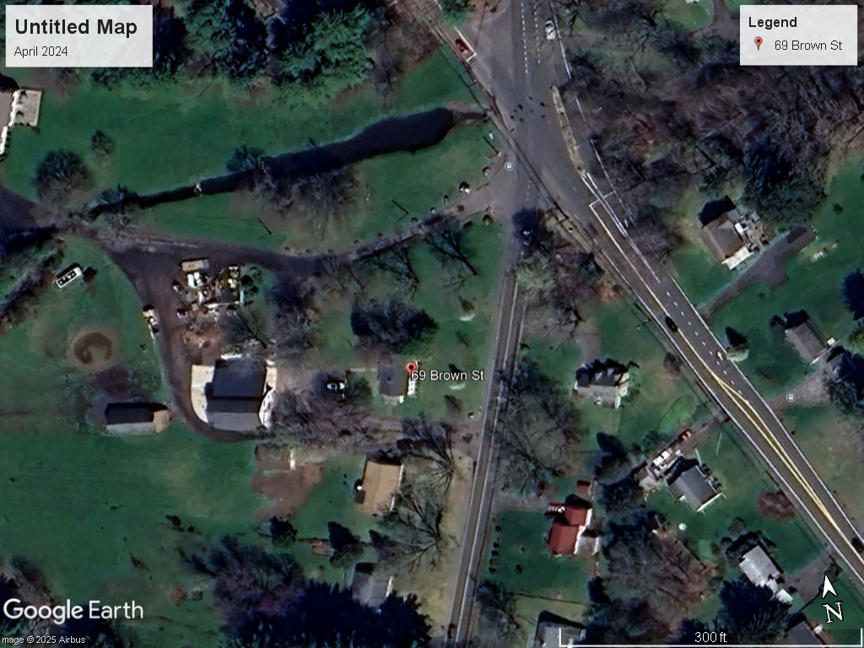
Google Photo
April 2024

Slide 5
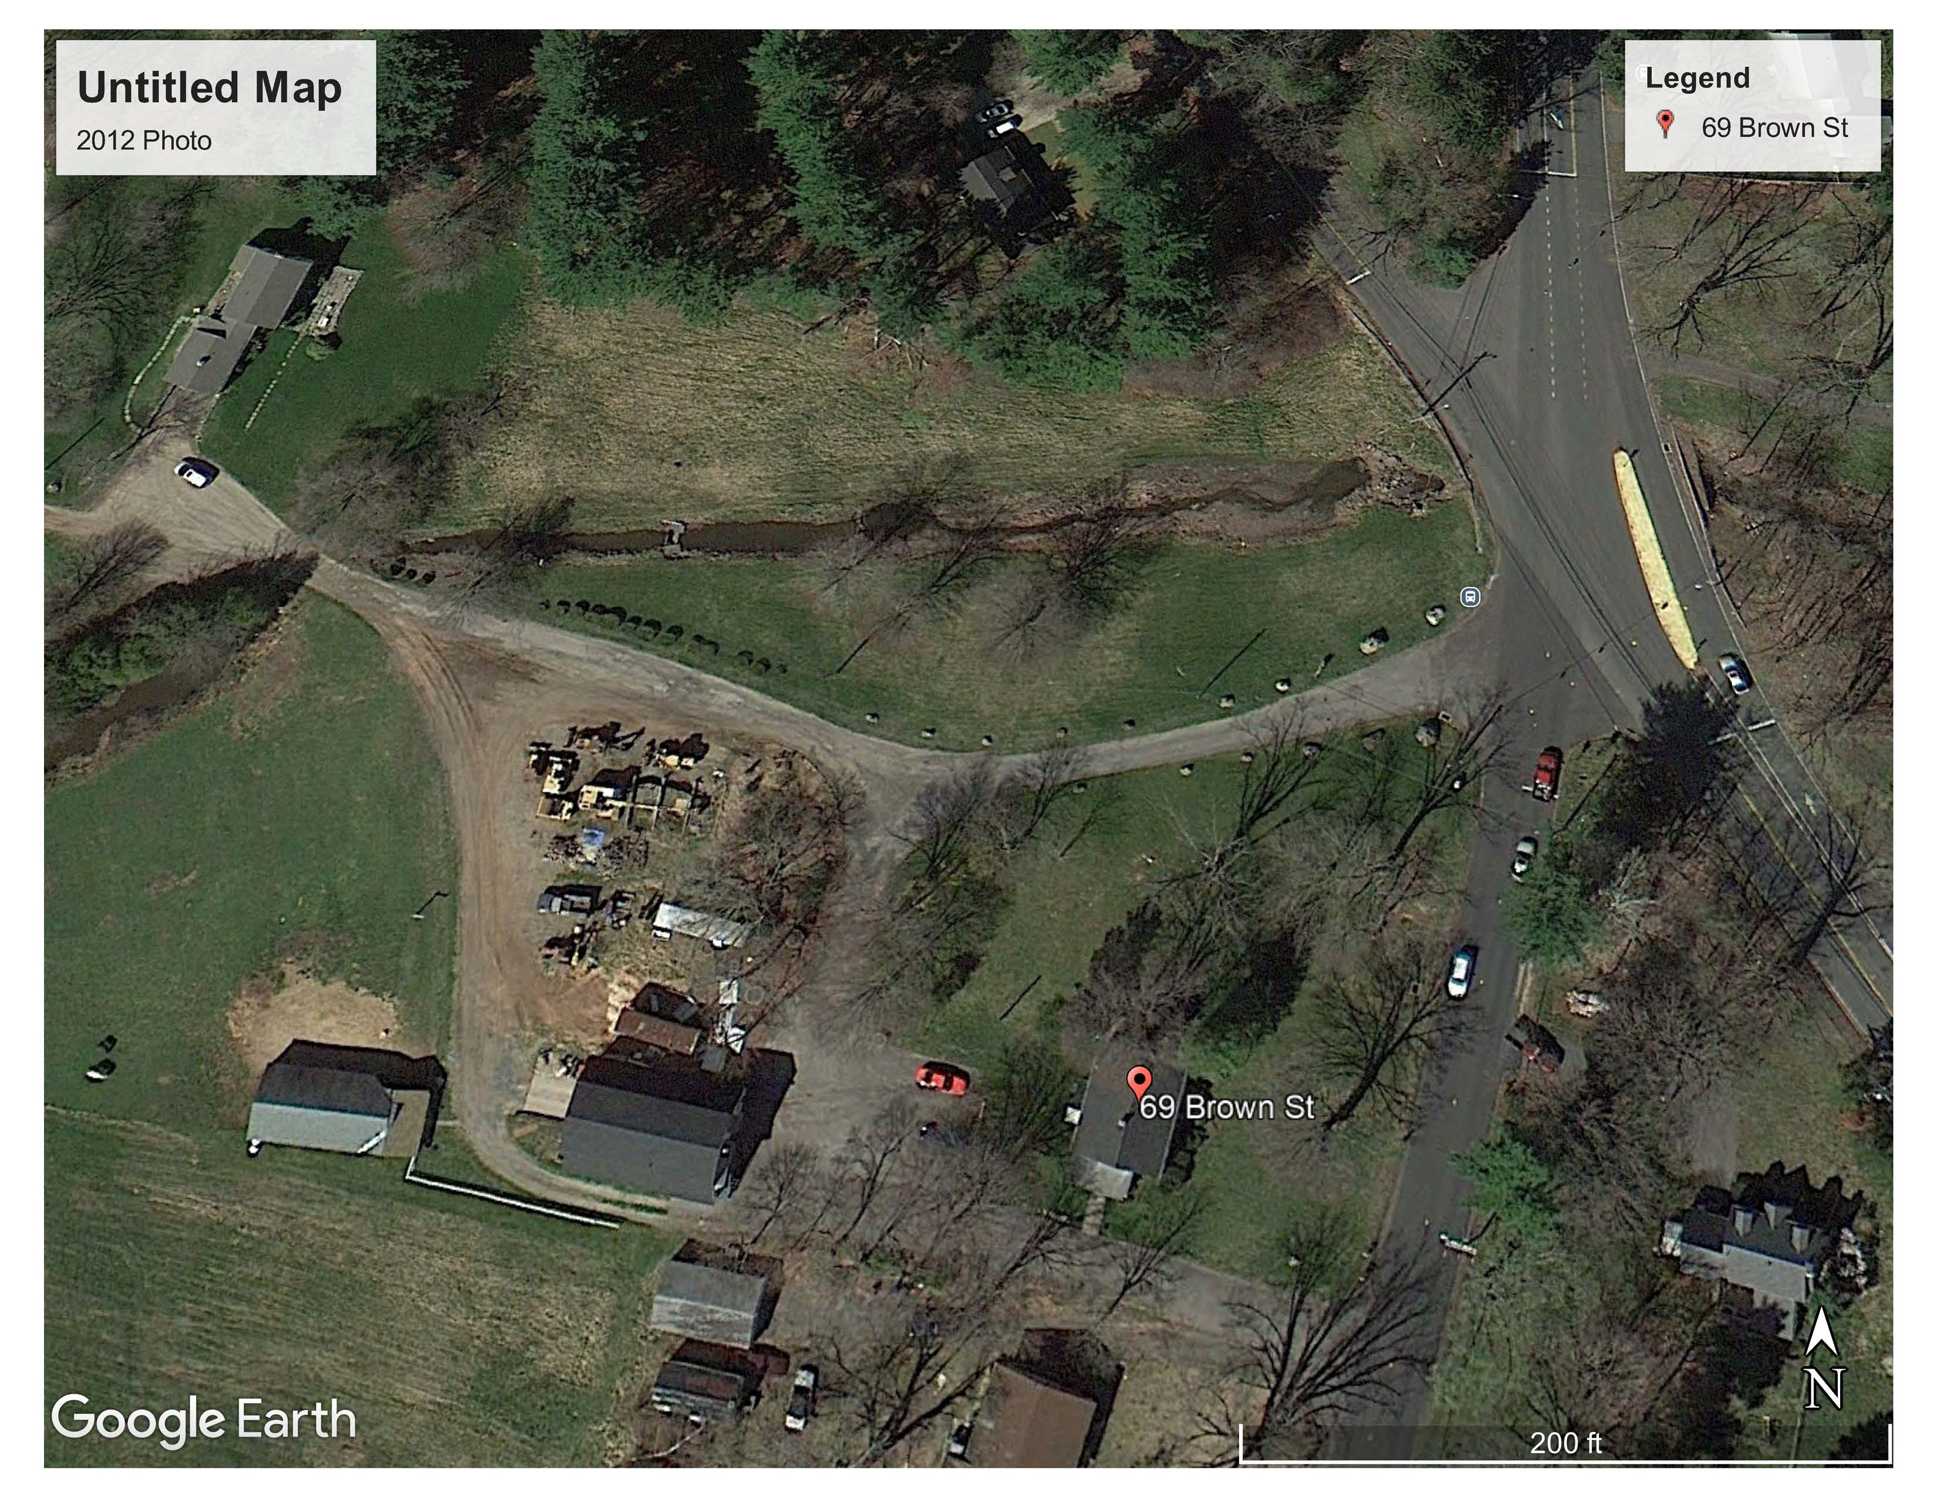
Google Photo
2012

Slide 6
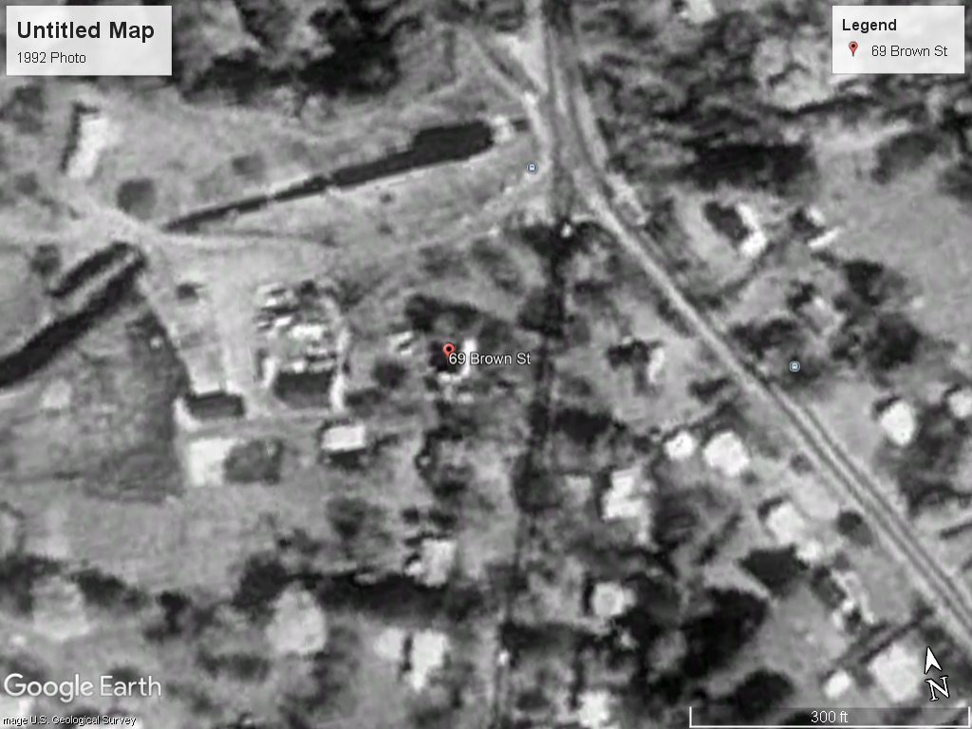
Google Photo
1992

Slide 7
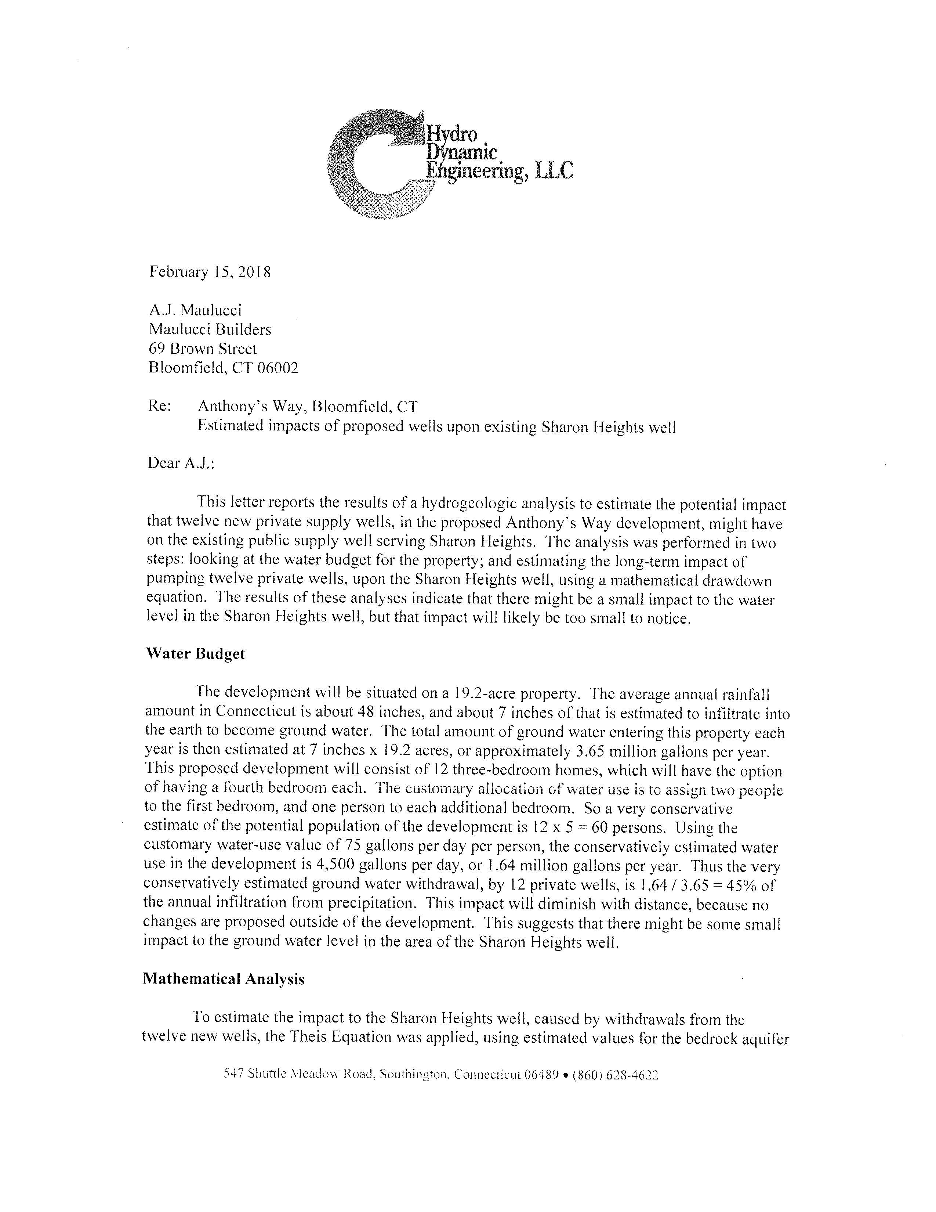
Letter to Maulucci Home Builders
2018

Slide 8
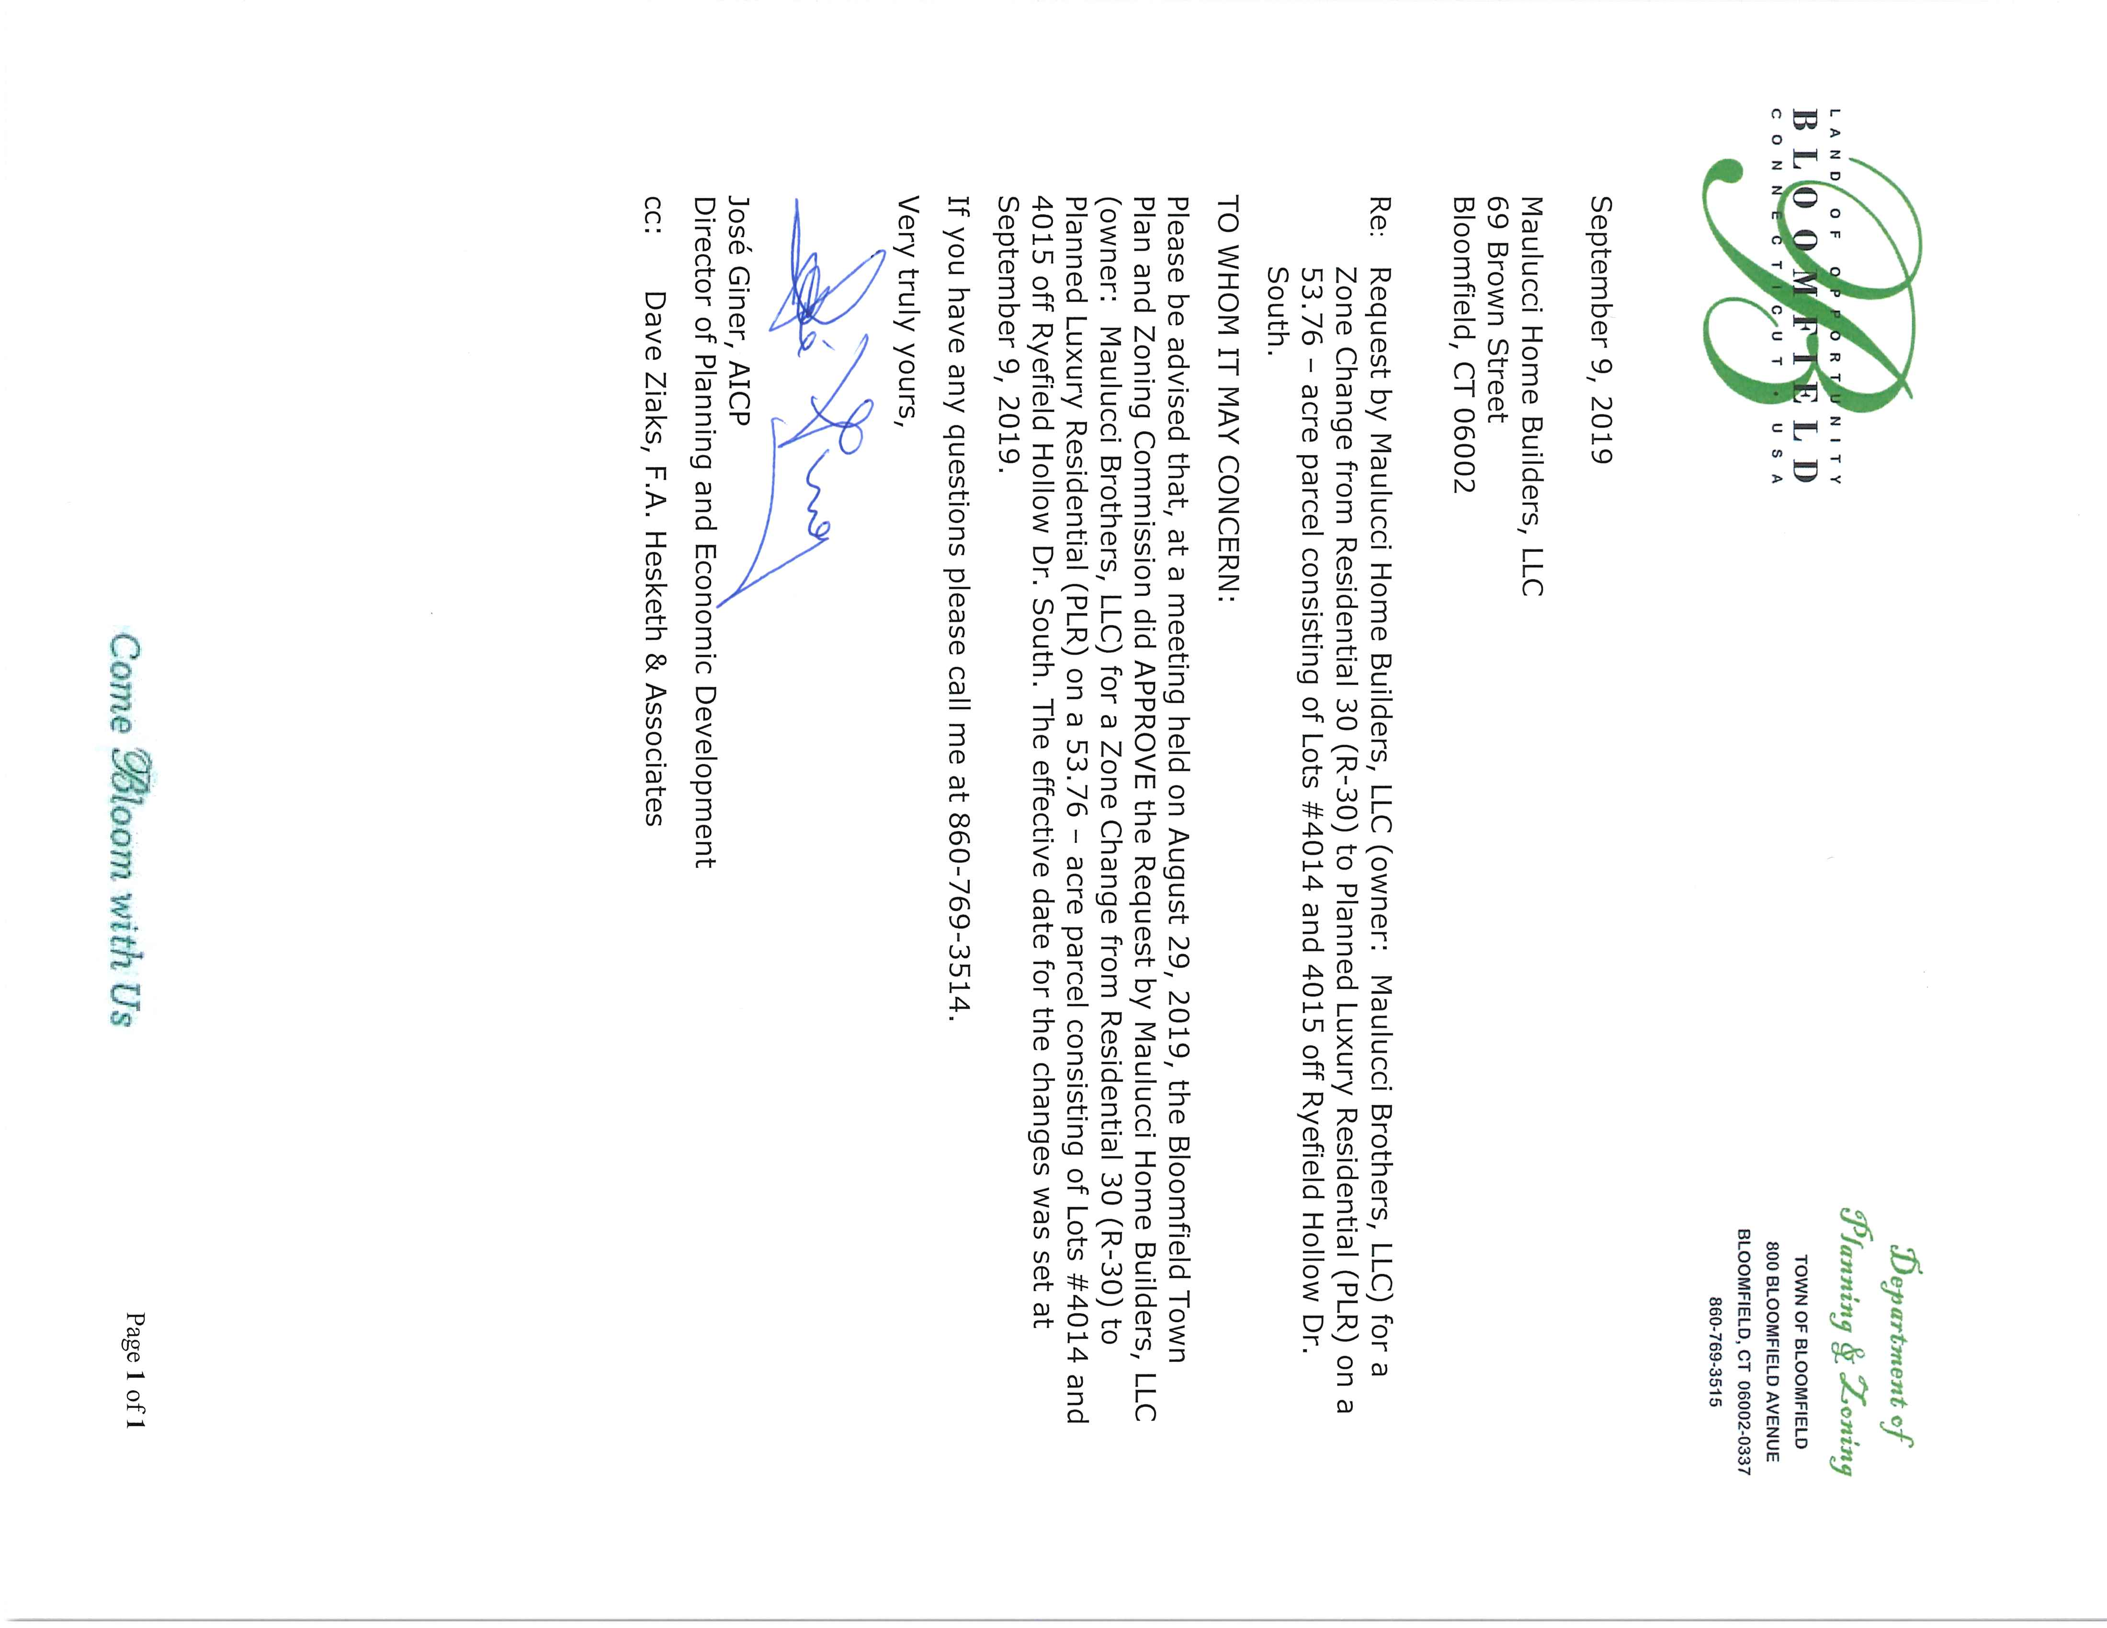
TPZ Approval Letter
2019

Slide 9

Bloomfield Business
Certificate
2001

